Slide 1


OBSTACLES AVOIDING ROBOT
MINOR PROJECT – I
REVIEW
BATCH - 16
BY :
GUHAN.A(927621BEC055)
ABINESH.R(927621BEC006)
ABISHEK.M(927621BEC007)
BALAJI.M(927621BEC021)
GUIDE:
Dr.E.DINESH A/P

Slide 2
LIST OF CONTENT
Abstract
Introduction
Components required
Method
Benefits
Future work
References
M.Kumarasamy College Of Engineering

Slide 3
ABSTRACT
Obstacle avoidance is task which is used for detecting the presence of object in a path of robot or any vehicle.
Obstacle avoiding robot is an intelligence device, which is used to protect the robot from any physical damages.
It automatically sense and overcome the obstacles on its path.
M.Kumarasamy College Of Engineering

Slide 4
INTRODUCTION
The obstacle avoiding robot will be able to avoid every obstacle in its path.
It will use an ultrasonic distance sensor and a servo motor in addition to the basic robot.
The robot will check how far the nearest obstacle is (in every direction) and then decide upon the actions to be taken.
M.Kumarasamy College Of Engineering

Slide 5
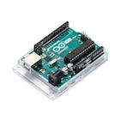
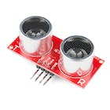
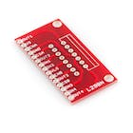
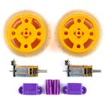
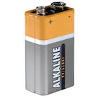
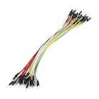
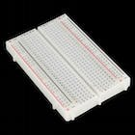
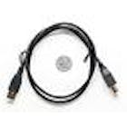
COMPONENTS REQUIRED
Arudino UNO
Ultrasonic sensor
Full bridge motor driver
DC motors,Fan
Wheels
Battery
Jumper wires
M.Kumarasamy College Of Engineering

Slide 6
METHOD
The obstacle avoiding robot will be able to avoid every obstacle in its path. It will use an ultrasonic distance sensor and a servo motor in addition to the basic robot. The robot will check how far the nearest obstacle is (in every direction) and then decide upon the actions to be taken.
The servo controls the direction in which the distance sensor faces and if the robot is hindered by an obstacle, the servo will rotate the sensor in different directions.
Once the robot is convinced that a certain direction is clear of any obstacles, it will turn the robot in that particular direction and then move in a straight line along that direction till the next obstacle is found. If there is no way to go ahead the robot executes a full 180° turn.
M.Kumarasamy College Of Engineering

Slide 7
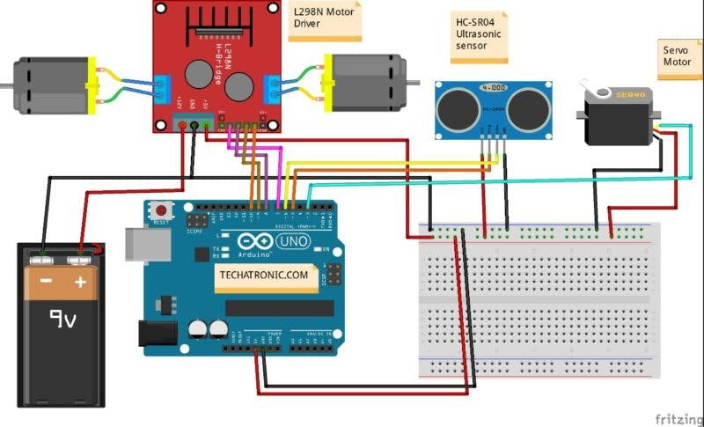




CIRCUIT DIAGRAM

Slide 8
BENEFITS
Addition thing in this robot is cleaning the room .
Which is very useful to save time
This technology is also used in dangerous environment where human penetration could be fatal
Use of this we can create an automatic future clean environment
M.Kumarasamy College Of Engineering

Slide 9
FUTURE WORK
By using this we can create an automatic AI environment
We add an cleaning parts from which the robot automatically clean the rooms
M.Kumarasamy College Of Engineering

Slide 10
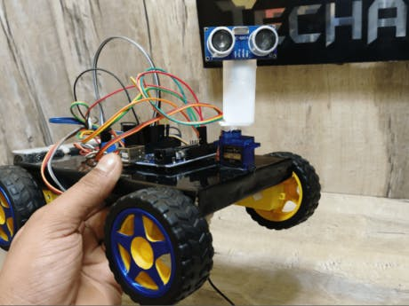
REFERENCES
We refer this from project hub
LINK:
https://create.arduino.cc/projecthub/Techatronic/obstacle- avoiding-robot-using-arduino-873332
M.Kumarasamy College Of Engineering

Slide 11
THANK YOU
M.Kumarasamy College Of Engineering

